Slide 1


Health Equity for Georgia’s Black Mothers
Track-1: Improving Individual Healthcare
Mother of All Data
Driven through Power of Data, AI & Open-source Application

Slide 2
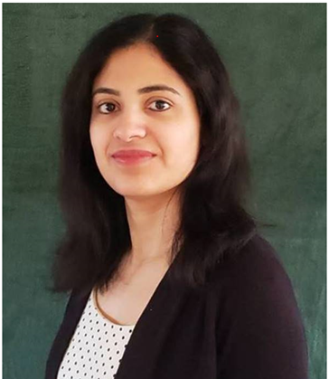




JNJ Team
Vinithra Rangarajan
IT Lead Comm Pharm Data AND Analytics
Mukunth Rajendran
Data Engineer
Jude Francis
Sr Manager Data Engineering
Sumanth Pottim
Manager ML and Data Engineer
Shilpa Rathod
IT Lead Comm Pharm Data AND Analytics

Slide 3
Problem Articulation
What is the problem or unmet need you are solving?
Black women are 2 to 3 times more likely to die from a pregnancy-related issues, when compared to others.
Data shows that the top 3 reasons for Maternal mortality among AA women are Preeclampsia, eclampsia, and embolism, out of these 60 % of these deaths are preventable.
AA community of Georgia has ~20% lower wellness index than others in Georgia.
The lower Wellness (health) index and lack of healthcare access are major contributing factors.
Explainable AI algorithm indicates BMI as one of the top three factors influencing wellness index.
Mobile health units to enable access to healthcare services.
Technology solutions to learn and predict potential beneficiaries.
Solution Approach

Slide 4
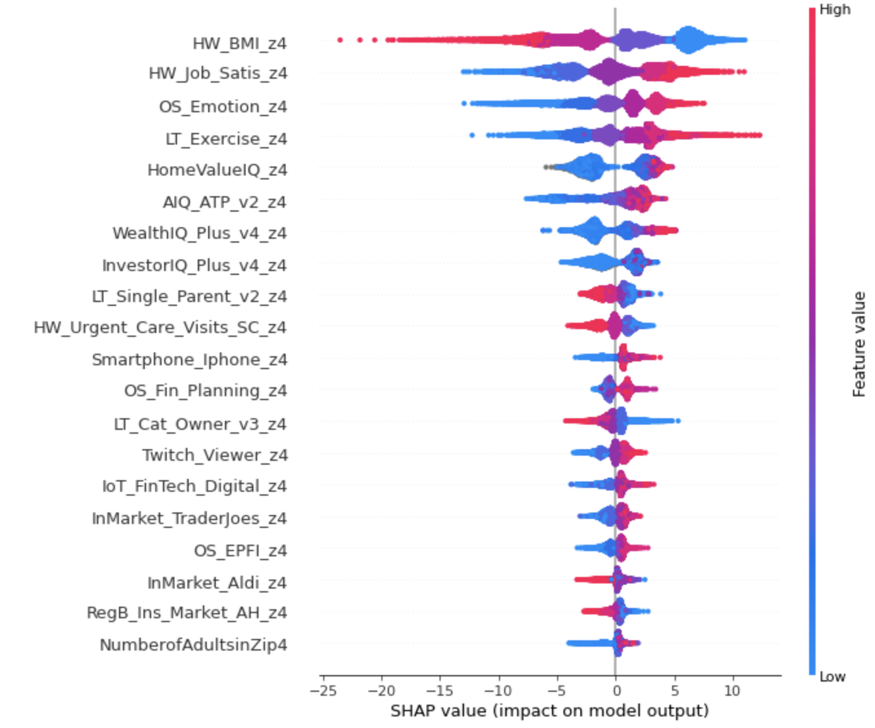
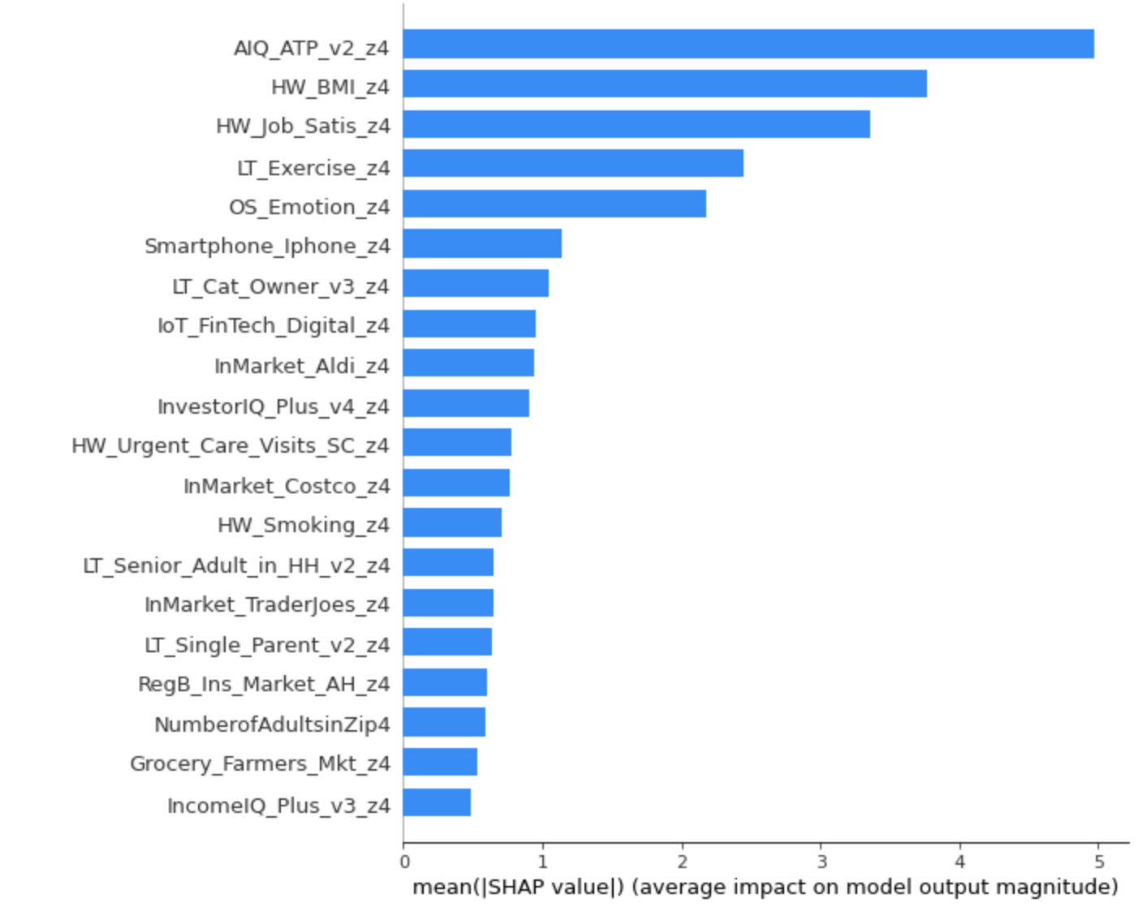
Explainable Artificial Intelligence (XAI) Insights on Important Features to Identify Overall Wellness Scale
African American Female Population
Data Source:
* Analytics IQ
Data Prep:
* Female Population
* Age between 18 to 50
* Dropped Other & Unknown Ethnicity
Algorithms:
* Used XGBoost Regressor to capture the important features
Insights:
* BMI has an inverse relationship with the target variable "Overall Wellness Scale"
The blue is a low value of the feature, the red is a high value of the feature​

Slide 5
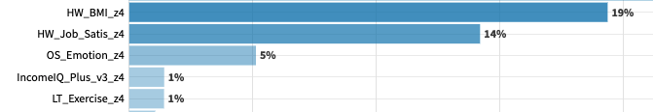
Collect census, geospatial data and build predictive analytics solution, which will help to identify communities of 18 to 50 years old black women who will benefit from our solution.
Partner with philanthropist organization to deploy Mobile health clinics in areas identified using AI/ML models.
Partner with technology organizations to provide free tools, like IOT devices with our open-source App for black mothers in need.
Work with local community leaders for outreach of the program.
This custom-built mobile App can be used to bring the services to the beneficiaries in need.
Collect feedback and evaluate the results on periodic basis to re-calibrate the program's success.
Scale the program based on the learning.
Impact:
Bringing awareness and access to easy health care and prevent maternal morbidity.
Up to 15% potential decrease in maternal mortality rate in Black woman
Opportunity to evaluate patients' health and (clinical decision support tools) predict early warnings & intervene to prevent mortality of mother.
Enable access to healthcare services for AA woman in Georgia
Notes:
This will provide education, resources and help black mothers need.

Slide 6
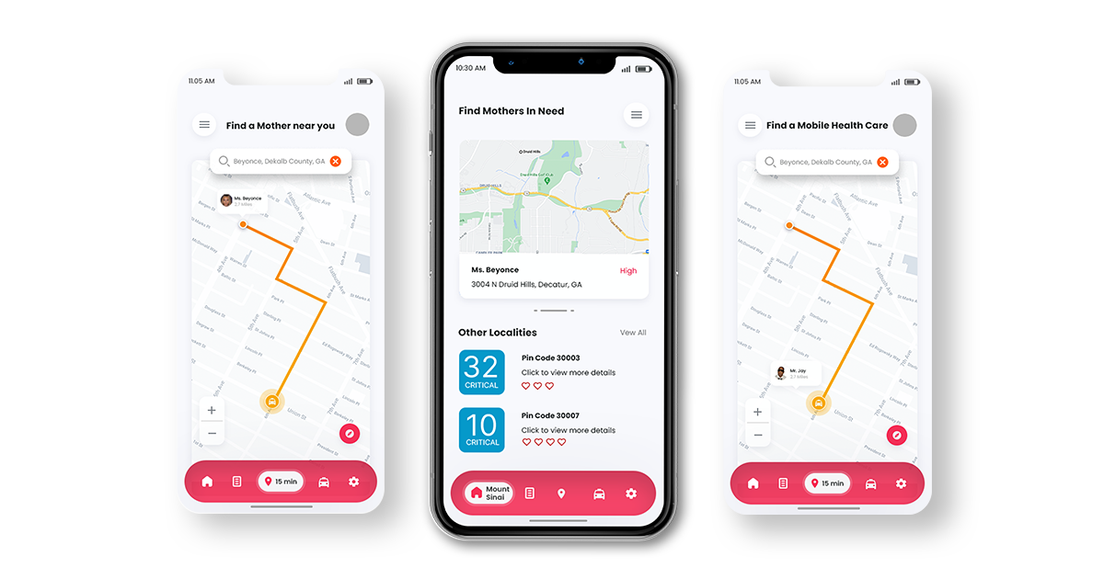
Application Visual/Prototype
Account/Health System View & Patient View
Health System View:
* Total number of potential beneficiaries in critical condition on a zip code level
* Criticality of the maternal mother – High, Medium & low
* Track Existing maternal services offered
* Predictions
Patient View:
* Time taken for the nearest mobile health clinics to reach the patient
* Track the journey of the service

Slide 7
High-Level Implementation Roadmap
# | Resources | Estimation
1 | Duration of the Project | 3 – 6 months
2 | Data Acquisition & Storage | $150K
3 | Open-Source App development | $150K
4 | AI Model Development | $100k
5 | Mobile or IOT Devices | Corporate Sponsors
6 | Program Management team | $350k
7 | Ongoing Support | $100k
 | Total | Onetime - $750k Ongoing - $450k
Skills Required: Program Management, Data Analytics, Data Science, Mobile App development and support
Implementation Approach: Rollout the pilot program in 3 counties, learn what works and pain points, refine the implementation approach and rollout for the entire state of GA and other communities and states as needed.

Slide 8
References
* https://pubmed.ncbi.nlm.nih.gov/29490333/
* https://www.ama-assn.org/delivering-care/population-care/examining-black-us-maternal-mortality-rate-and-how-cut-it
* https://www.ncbi.nlm.nih.gov/pmc/articles/PMC6316192/
* https://www.everydayhealth.com/diet-nutrition/bmi/how-you-reduce-your-bmi-science-backed-steps/
* http://stopcancerfund.org/pz-diet-habits-behaviors/eating-habits-that-improve-health-and-lower-body-mass-index/
* https://gbpi.org/extend-postpartum-medicaid-coverage-to-improve-maternal-health-in-georgia/
* https://aws.amazon.com/machine-learning/what-is-ai/
* https://equityhealthj.biomedcentral.com/articles/10.1186/s12939-020-1135-7
GitHub
https://github.com/MukunthR/Mother-of-All-Data

Slide 9
Thank you

